Slide 1
Web Fundamentals Project
Mouhamed Oussema Hidri

Slide 2
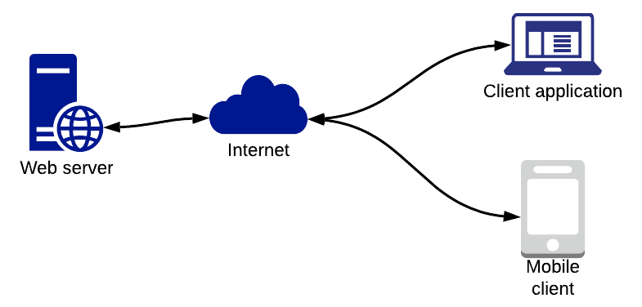
How does the web work?
A user enters a URL into a browser. This request is passed to a domain name server.
The domain name server returns an IP address for the server that hosts the Website
The browser requests the page from the Web server using the IP address specified by the domain name server.
The Web server returns the page to the IP address specified by the browser requesting the page.
The browser collects all the information and displays to your computer in the form of Web page.

Slide 3
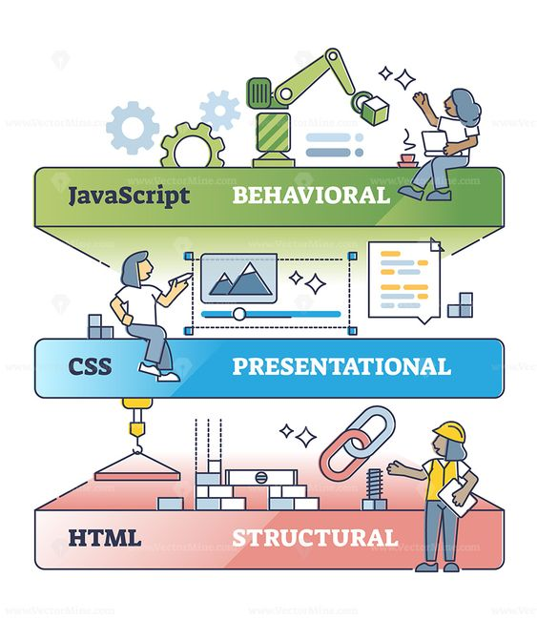
What do you need to be a web developer?
Web development is the process of creating and maintaining websites,
it’s the work that goes on behind the scenes to make a website appear attractive
To become a Web Developer, you should have an understanding of HTML, CSS, and JavaScript. It's also recommended to learn about CSS and CSS frameworks

Slide 4
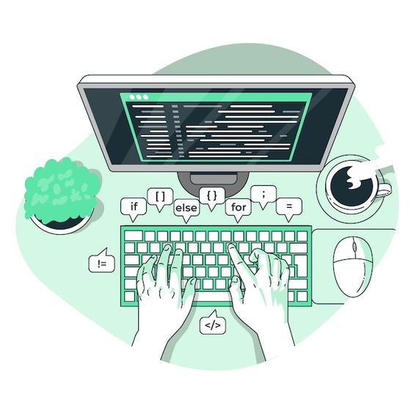
Why did I choose to learn web development?
Actually I choose learning web Development because I love IT since I'm young so I thought to start a professional retraining with GOMYCODE, as a FULL-STACK DEVELOPER, so I'm passionate to learn more about this industry,
On top of all this, there is a funny desire that fascinates me. Web development allows me to work from any place at any time so that I can travel the world (my xD of dream) without losing my job,
I hope you'll help me make my dreams come true.

Slide 5
Word’s meaning:
URL: a Uniform Resource Locator (URL), colloquially termed as a web address
Domain: A domain is the name of a website, a URL is how to find a website,
IP address: An IP address is a unique address that identifies a device on the internet or a local network.
HTML: is the standard markup language for creating Web pages.
CSS:(Cascading Style Sheets) is used to style and layout web pages
JavaScript: is a scripting language that enables you to create dynamically updating content, control multimedia, animate images, and pretty much everything else.
FULL-STACK DEVELOPER: a developer or engineer who can build both the front end and the back end of a website.
Thanks for examining my checkpoints

